Slide 1
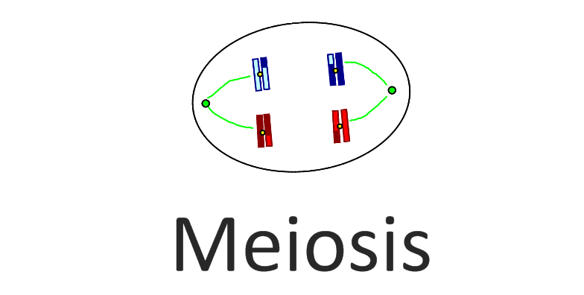

Slide 3
Remember Microtubules?
GFP Staining to see movement of microtubules & Chromosomes: https://www.youtube.com/watch?v=JMAg_PwSMjA
GREAT Video on molecular modelling of microtubules (Start ~ 5:45): https://www.youtube.com/watch?v=dMPXu6GF18M

Slide 13
Bivalent
=Tetrad
~Homologous Pair

Slide 25
as a result of an error in Metaphase

Slide 32
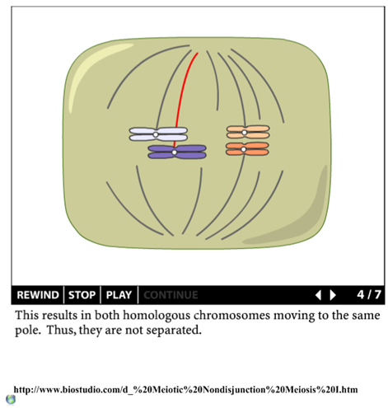
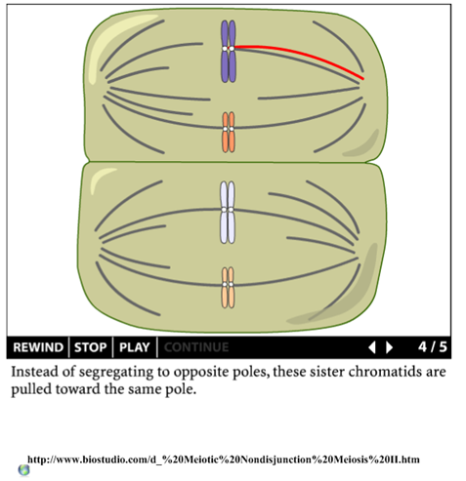

Slide 47
